Slide 1

Stock trading with RL
Part 1: 11/07/2023
Jonas, Lorena, Mohamad, Viktoria

Slide 2
Contents
Basic framework: Automated Stock Trading
Datasets and APIs
Add-Ons Ideas
Literature and Resources
Open Questions

Slide 3
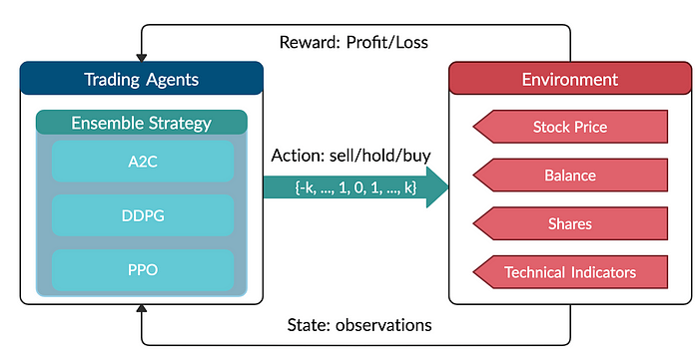


Basic framework: Automated Stock Trading

Slide 4
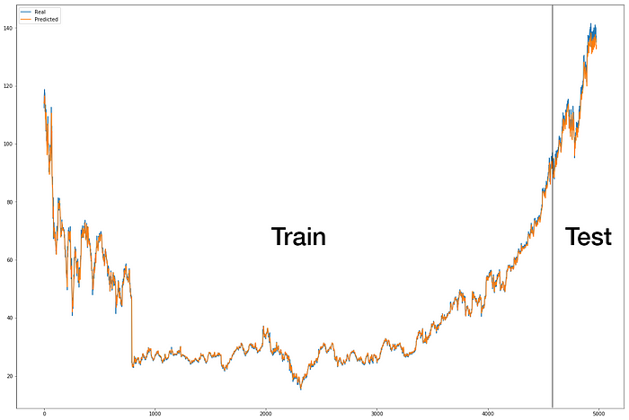
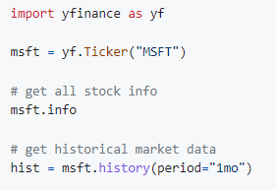

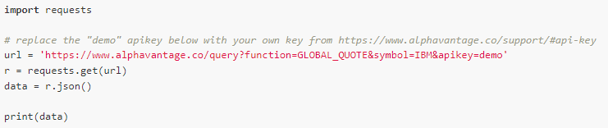

Datasets and APIs
Realtime & historical stock market data APIs

Slide 5
Add-Ons Ideas
Robo-advisor:
Combine historical stock market data with alternative data (e.g., Twitter sentiment, …)
Interact with the client to determine their risk preference
Market Making:
Leverage the Limit Order Book use the robo-advisor as market maker
Option Pricing and Hedging:
Extend vanilla stock trading by complex derivatives (e.g., options) to hedge risks

Slide 6
Literature Research
Review Paper RL in Finance: https://arxiv.org/abs/2112.04553
Datasets and APIs: https://rapidapi.com/blog/best-stock-api/
Dataset and LSTM implementation: https://towardsdatascience.com/getting-rich-quick-with-machine-learning-and-stock-market-predictions-696802da94fe
Custom OpenAI Gym Environment: https://towardsdatascience.com/creating-a-custom-openai-gym-environment-for-stock-trading-be532be3910e
Tutorials and Implementations:
FinRL https://github.com/AI4Finance-Foundation/FinRL
Deep RL AutoStock: https://towardsdatascience.com/deep-reinforcement-learning-for-automated-stock-trading-f1dad0126a02

Slide 7
Open Questions
What is meant with “technical indicators: Neural-Network Sensitivity Analysis”?

